Slide 1

AI based diabetes
Prediction system:-

Slide 2
Name: valarmathi.k
Department: Biomedical engineering
Project Name: AI based diabetes prediction system
Course name: Artificial intelligence

Slide 3
SECTION ONE
Introduction
Output
5
1
Challenges
2
Diabetes prediction
Machine
6
3
Flow chart
Import libraries
4

Slide 4
1.Introduction
A system is used to predict whether a patient has diabetes based on some of its health-related details such as BMI (Body Mass Index), blood pressure, Insulin, etc. This system is only for females as the dataset used to make this system exclusively belongs to the females.
Here, it is required to have an accuracy of the model to predict the correct result, as it is about someone's health. A single wrong result can have an adverse effect. Therefore, a good accuracy "Random Forest Classifier" Random Forest model is selected, which provides good accuracy to the system and generates the correct results.

Slide 5
2.challenges in diabetes prediction
Objectives: Indigenous populations around the world have a higher health disparity and an increased risk of diabetes. Scientific literature on the prevalence of diabetes in India is not available, and the current work is a pilot study to explore the risk of diabetes in one such indigenous population in India.
Study design: This is a cross-sectional survey and screening study.

Slide 6
Methods: The study took place in a remote tribal hamlet of Machuru in South India. A door-to-door survey was conducted in the hamlet with a population of 555. The Indian Diabetes Risk Score (IDRS) questionnaire was completed by 160 individuals older than 25 years. Capillary blood glucose levels were measured to compare the glycaemic status with the predicted IDRS.
Results: Of 160 adults who completed the questionnaire, 37 were at high risk (23.13%) as per the IDRS, 52 at medium risk (32.5%) and 71 at low risk (44.38%). None of the respondents knew their family history of diabetes owing to the lack of awareness about the condition. Interestingly, the villagers had a sedentary lifestyle owing to their unique family dynamics but a healthy diet. Five participants were diagnosed with diabetes, and 18 were diagnosed with impaired fasting glucose or prediabetes.

Slide 7
Conclusions: The IDRS might not be an accurate measure to understand the risk of diabetes in this particular population owing to their unique family dynamics and a lack of awareness about diabetes. The best possible way to assess the diabetes risk might be through blood examination.

Slide 8
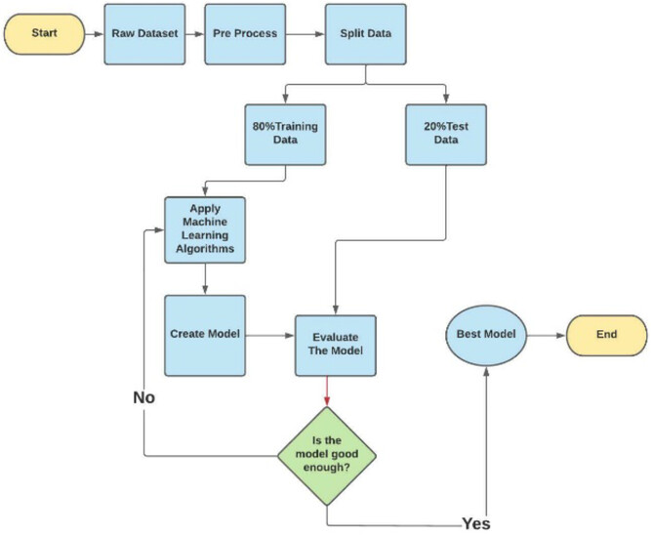
3.Flow chart

Slide 9
4.lmport libraries
import numpy as np
import pandas as pd
import matplotlib.pyplot as plt
import seaborn as sns
sns.set()
from mlxtend.plotting import plot_decision_regions
import missingno as msno
from pandas.plotting import scatter_matrix
from sklearn.preprocessing import StandardScaler
from sklearn.model_selection import train_test_split
from sklearn.neighbors import KNeighborsClassifier
from sklearn.metrics import confusion_matrix
from sklearn import metrics
from sklearn.metrics import classification_report
import warnings
warnings.filterwarnings('ignore')
%matplotlib inline

Slide 10
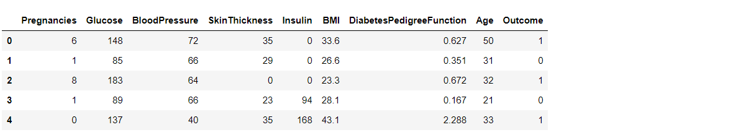
5.output

Slide 11
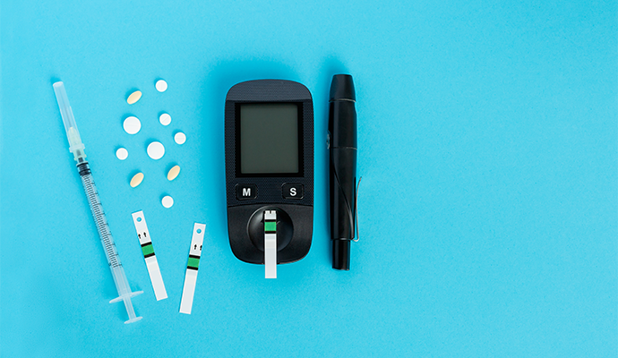
6.Diabetes prediction machine

Slide 12

THANK YOU
Standing on high and learn to lay down the body Windy will understand muzzled some clothes

